Slide 1
Dream VC Brand Guidelines
Have a read if you have questions or thoughts about how to use the Dream VC Brand colours or descriptions. Don't worry - it's not too long and there's not much legal jargon! Got more questions or not sure about your use case? Email brand@dream-vc.com and we'll be happy to clarify it for you.

Slide 2
Dream VC Icon ‘Rectangle Area’ No BG
Dream VC Icon ‘Square Area’ No BG
Dream VC Icon WebP Greyscale
Dream VC Icon PNG Greyscale

Slide 3
Dream VC Icon ‘Rectangle Area’ No BG
Dream VC Icon ‘Square Area’ No BG
Dream VC Icon WebP Greyscale
Dream VC Icon PNG Greyscale

Slide 4
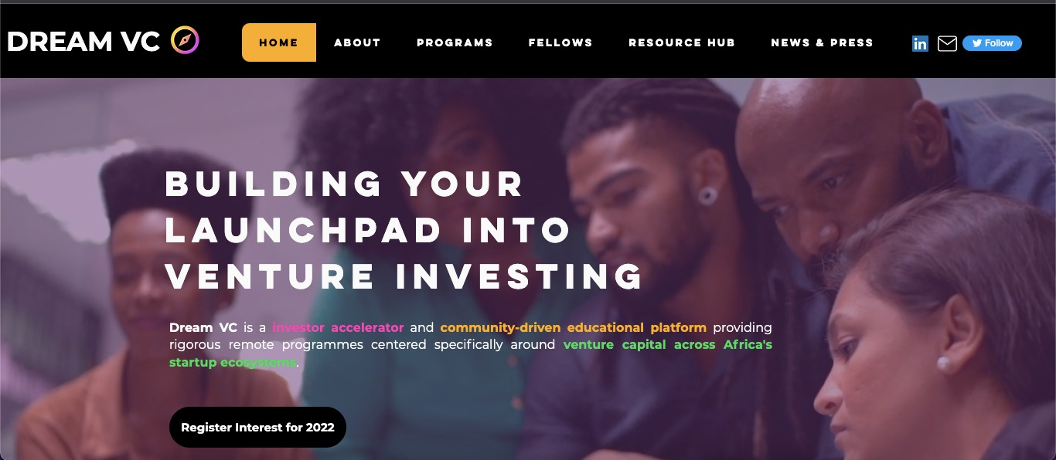
Dream VC Banner

Slide 5
SOCIAL HANDLES – Dream VC
Twitter - @_dreamvc_
LinkedIn – @Dream-VC
SOCIAL HANDLES – CINDY AI
Twitter - @Aimnotsydney
LinkedIn – @CindyAi
SOCIAL HANDLES – Dream VC
Twitter - @MarkKleyner
LinkedIn – @MarkKleyner

Slide 6
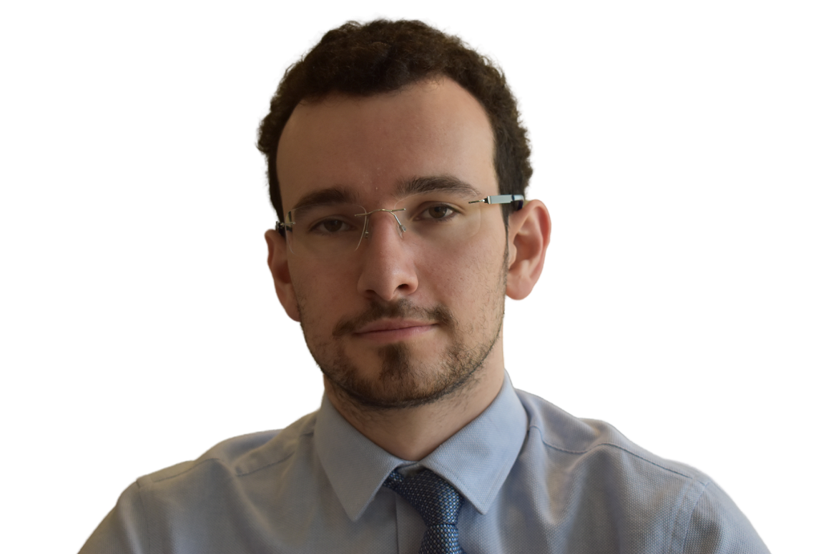
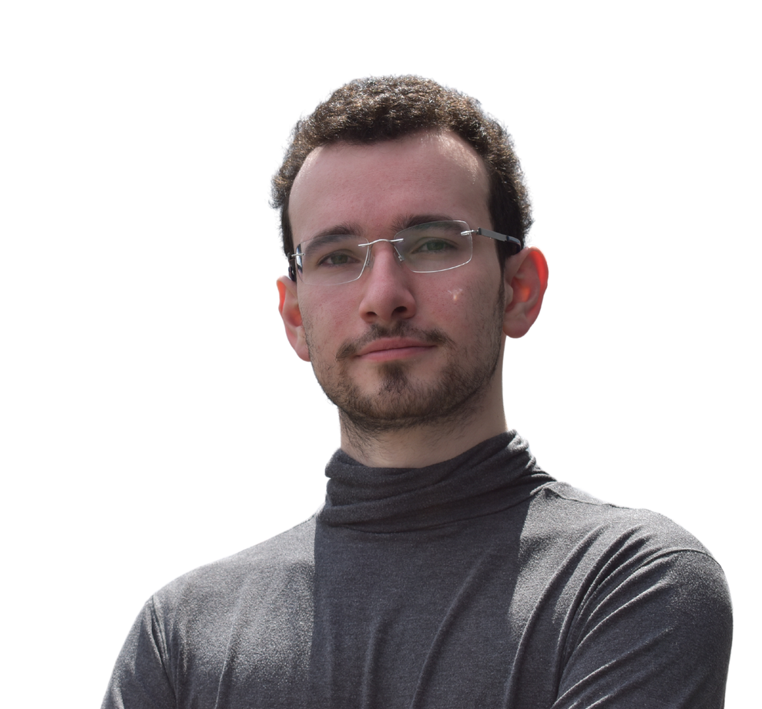
Mark Kleyner Pictures

Slide 7
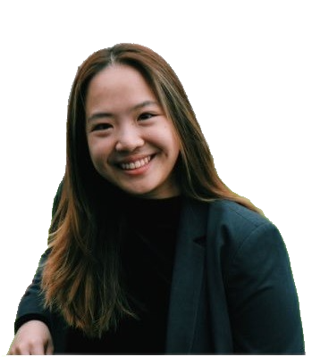
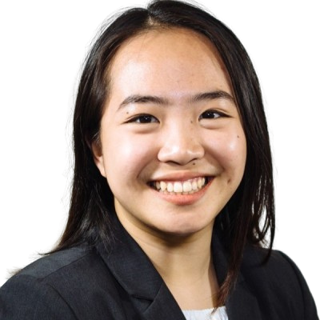
Cindy Ai Pictures

Slide 8
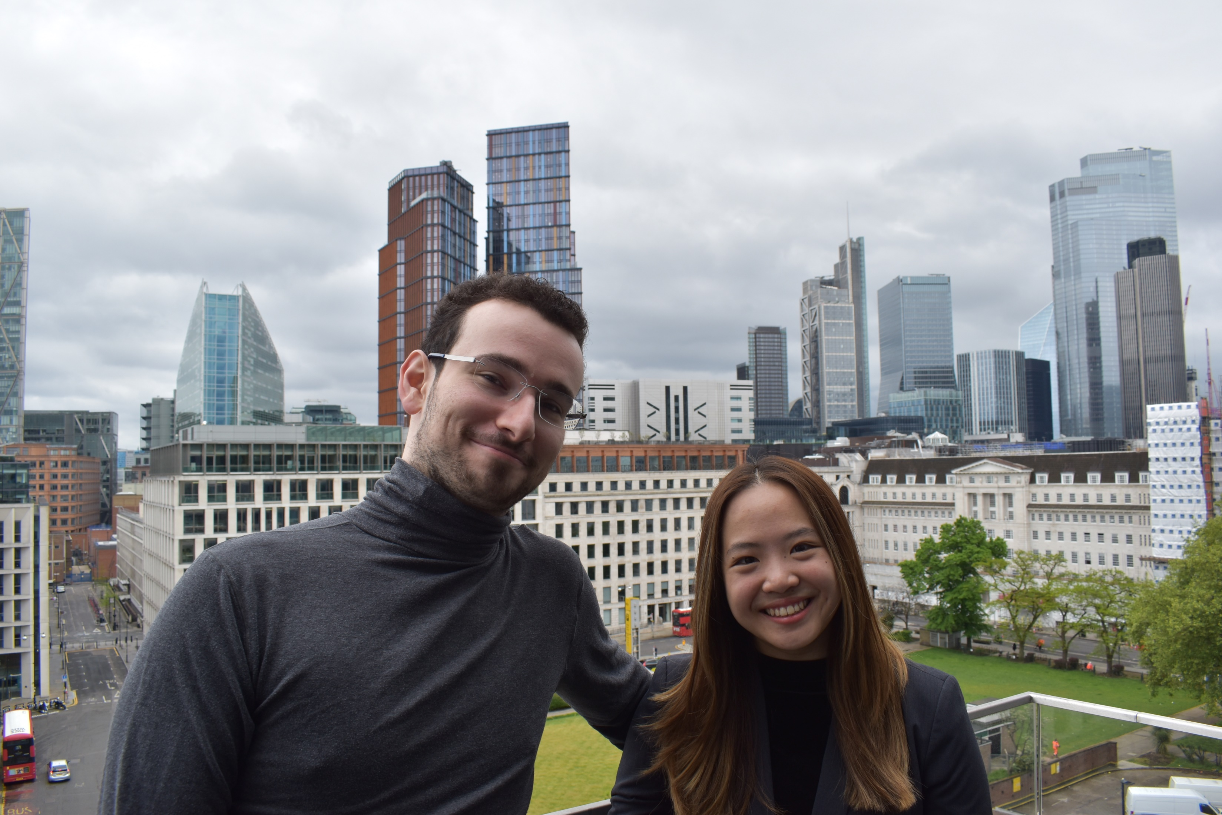
Mark and Cindy Pictures
Mark and Cindy Pictures

Slide 9
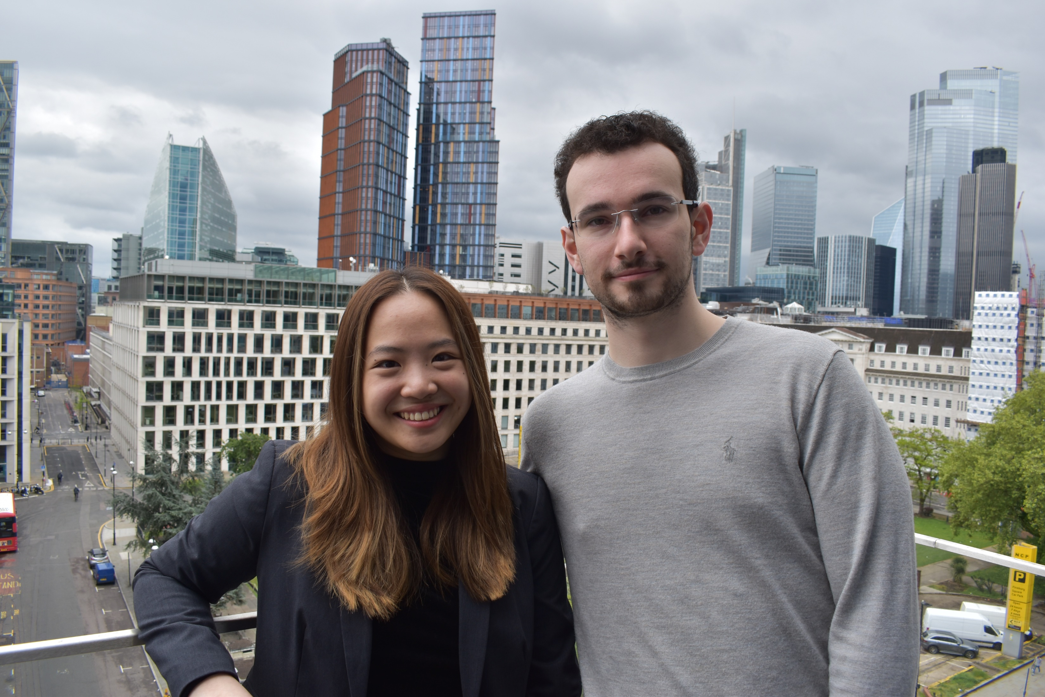
Mark and Cindy Pictures

Slide 10
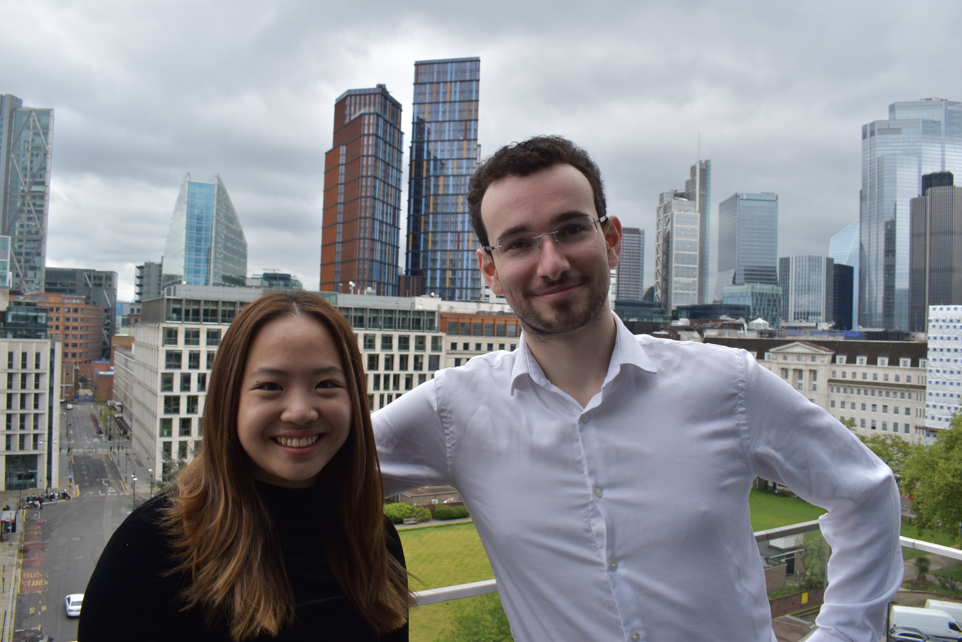
Mark and Cindy Pictures

Slide 11
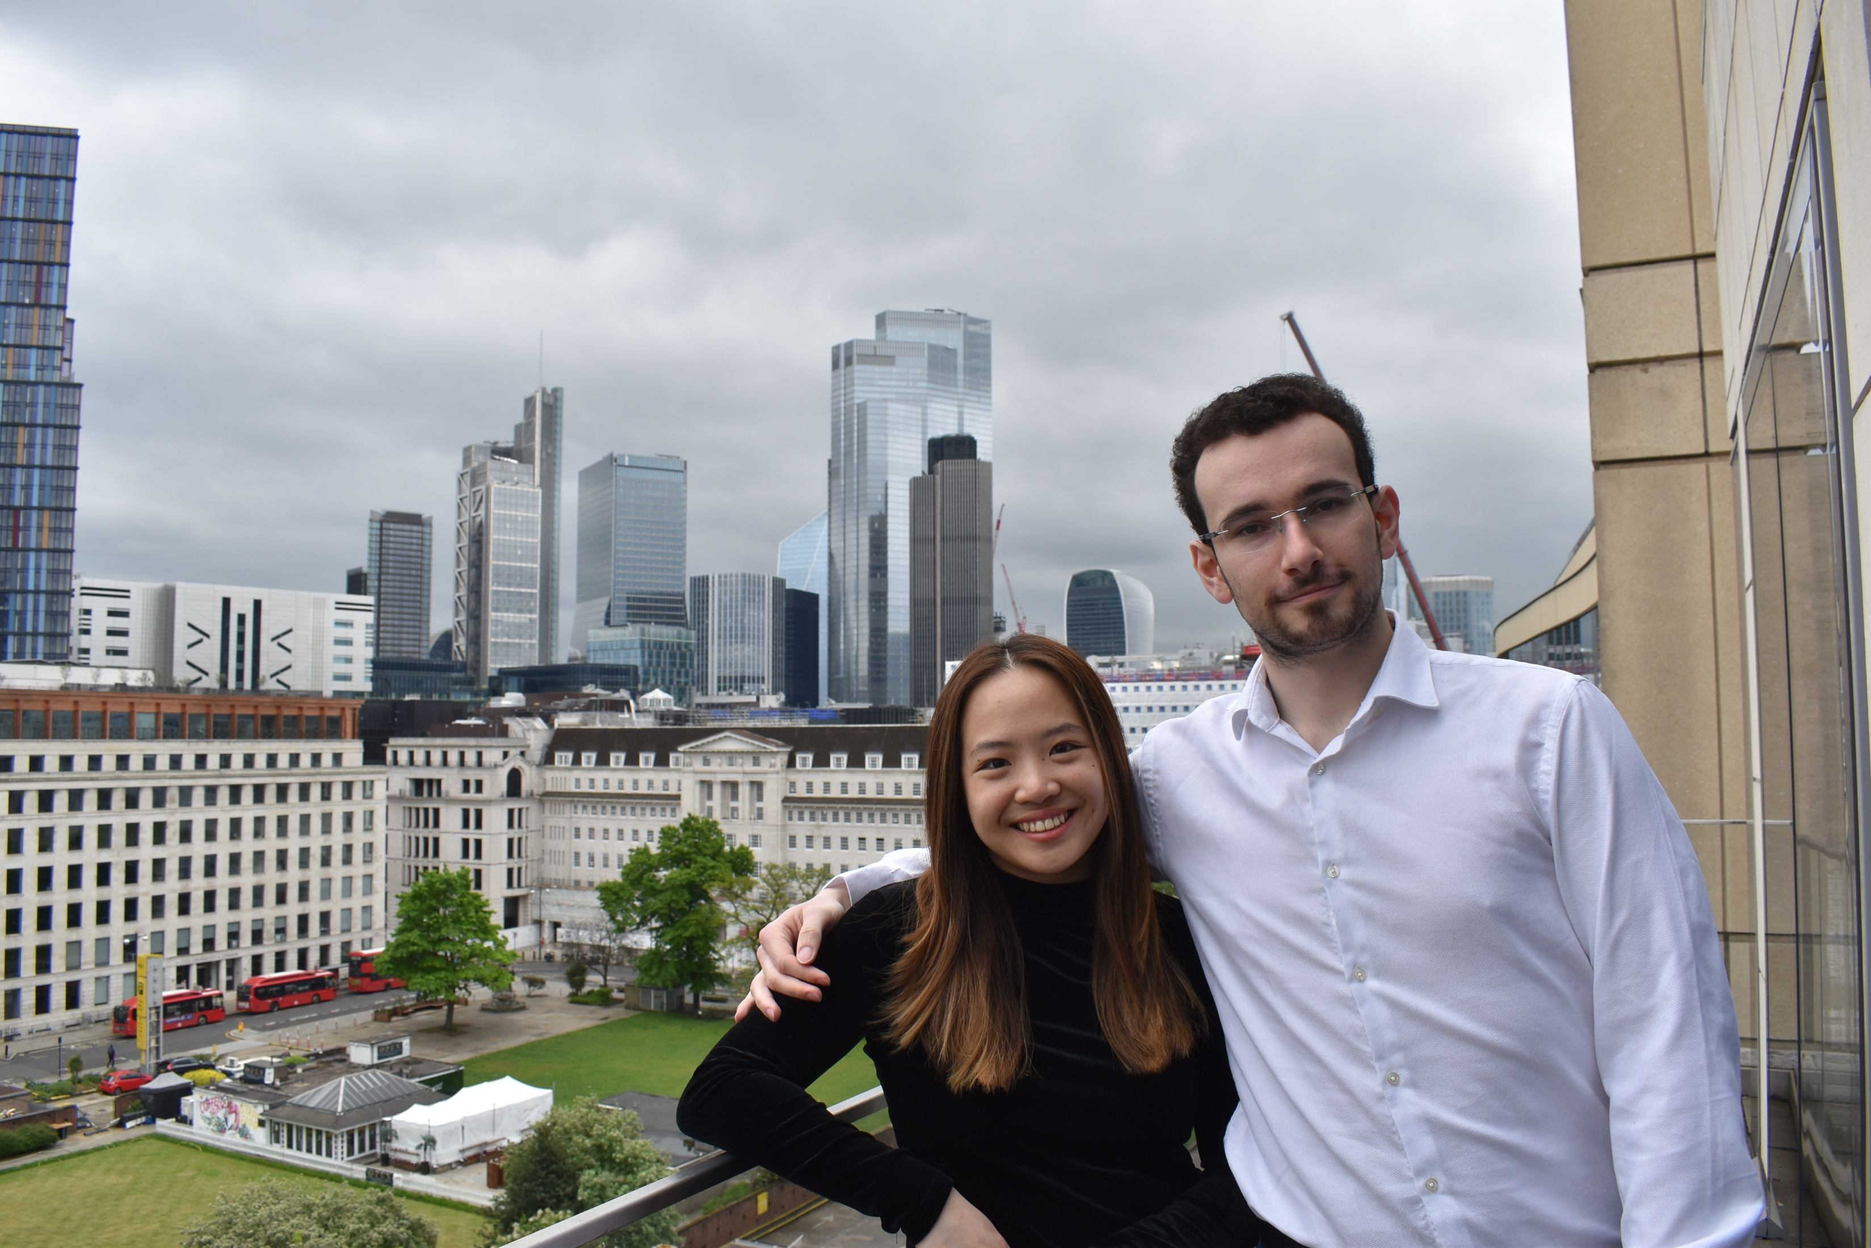
Mark and Cindy Pictures

Slide 12
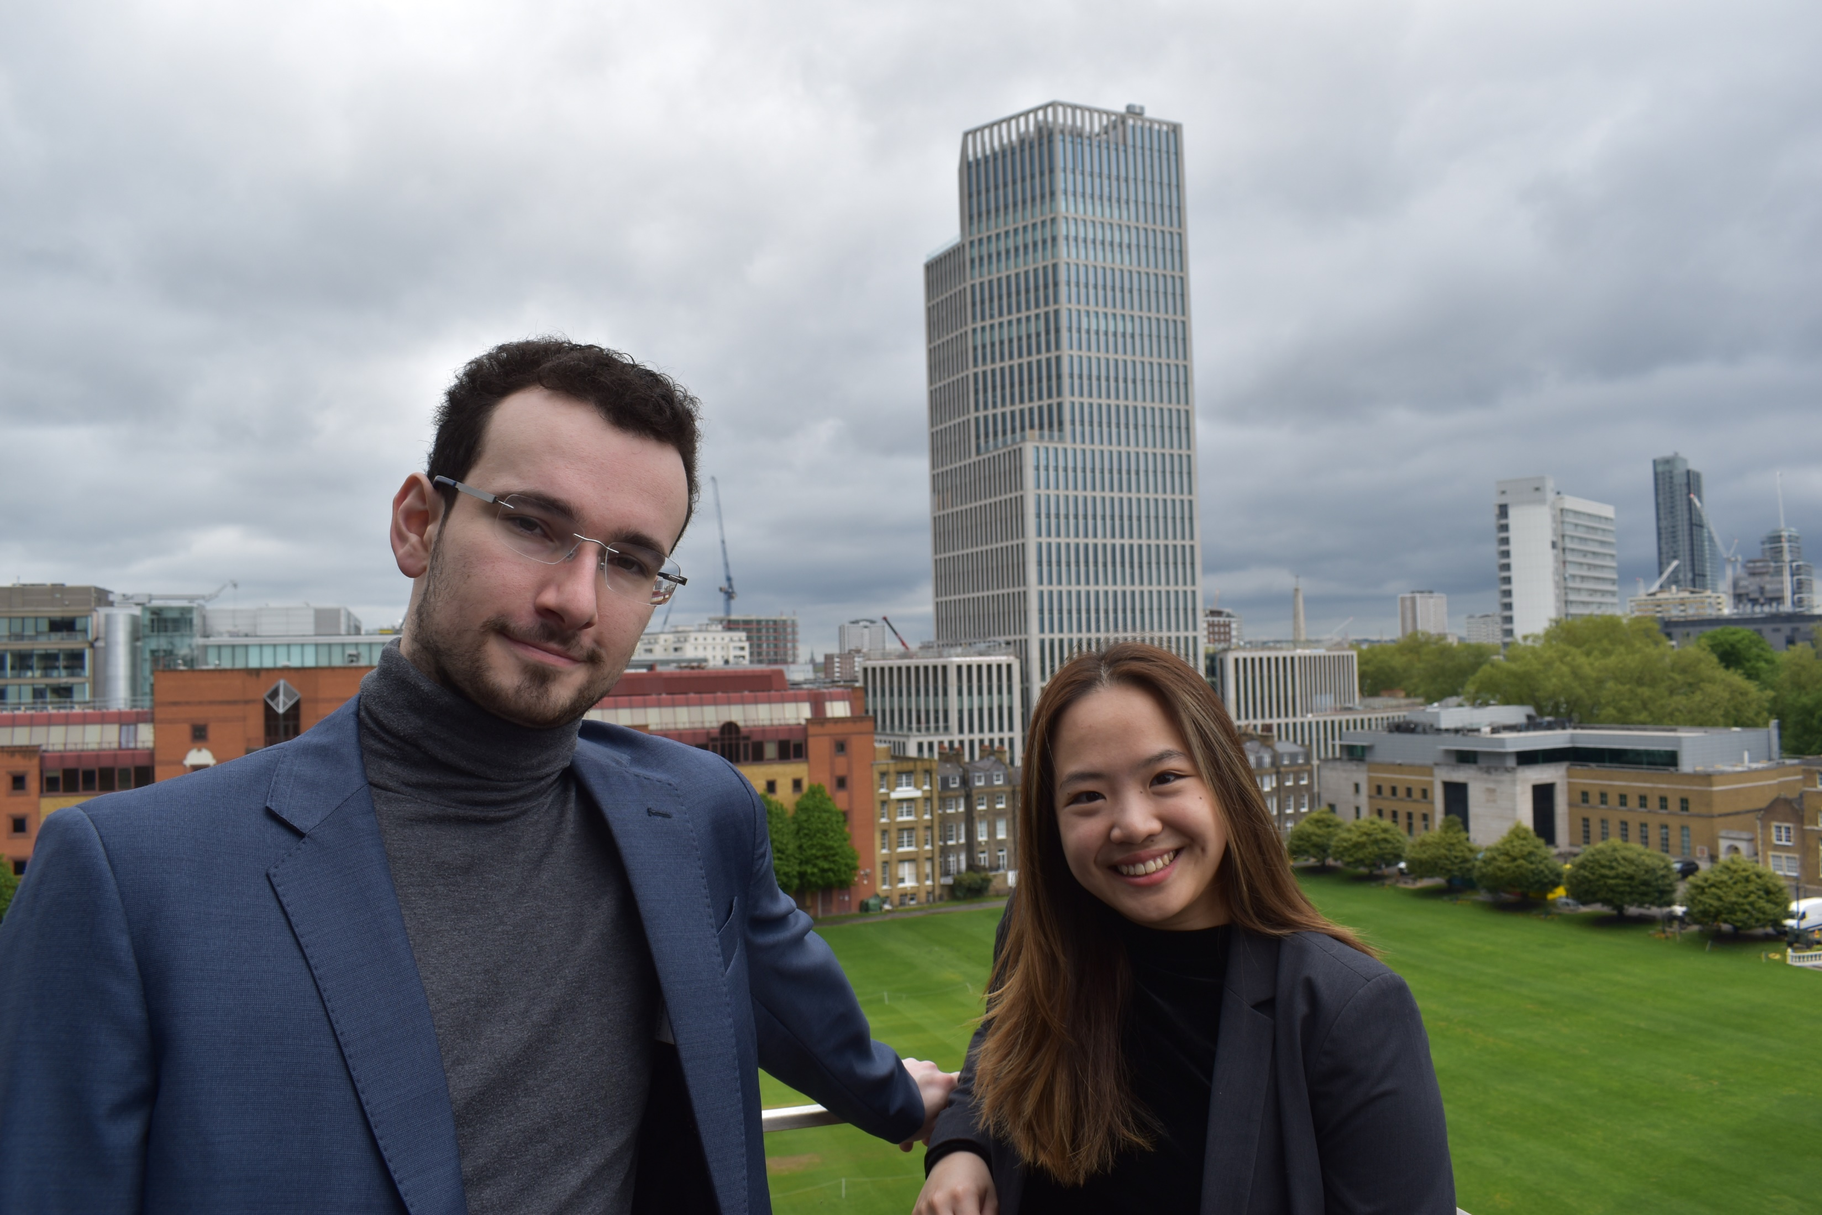
Mark and Cindy Pictures

Slide 13
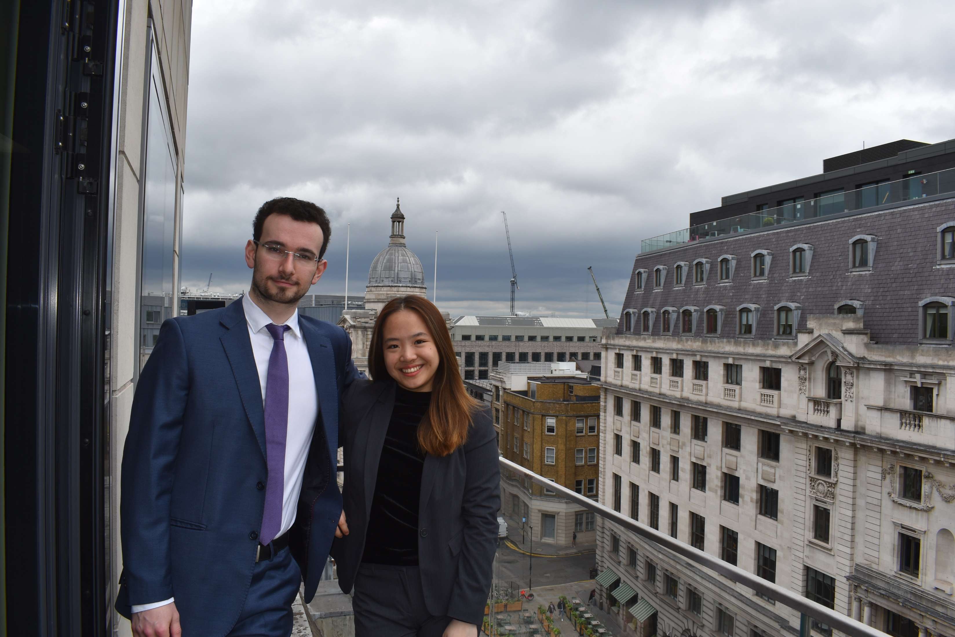
Mark and Cindy Pictures

Slide 14
Dream VC Description Medium Length – From Dream VC LinkedIn
Dream VC Description Short Length – From Dream VC Website
Dream VC is an investor accelerator and community-driven platform providing rigorous remote programmes for aspiring African investors centering around venture capital. Dream VC aims to catalyze the next generation of African investors, with a particular focus on driven and underrepresented individuals (homegrown Africans, diaspora, and beyond) who wish to be impactful ecosystem builders in their communities.
Dream VC is a investor accelerator and community-driven educational platform providing rigorous remote programmes centered specifically around venture capital across Africa's startup ecosystems.

Slide 15
Mark is an entrepreneur, ecosystem builder and early-stage VC in Emerging Markets. Mark is currently the co-founder and programme director of Dream VC, an investor accelerator and community-driven educational platform providing rigorous remote programmes centered around the venture capital industry across Africa's startup ecosystems. A multi-time founder, Mark has worked within VCs in the UK, US, Europe and Africa and actively advises, coaches and mentors several very early-stage West & East African startups - who have gone on to raise upwards of $10m in Venture Financing, and joined programs like Google's BFFA, PioneerApp, TechStars and YC. Beyond these activities, Mark is an active startup mentor in 9+ Accelerators and Incubators at StartupBootcamp, Impact Hub Lagos, Seedstars, Founder Institute and Village Capital. Mark’s expertise centers around Venture Building, especially within the Consumer and Enterprise Technology sectors, but he actively works with startups in sectors including FinTech, AgriTech, Logistics and more.
Biographies

Slide 16
Cindy is a former startup operator and entrepreneur turned ecosystem builder working on catalyzing the African investor pipeline. Cindy is currently the co-founder and programme director of Dream VC, an investor accelerator and community-driven educational platform providing rigorous remote programmes centered specifically around venture capital across Africa's startup ecosystems. Prior to Dream VC, Cindy worked across many intersections of innovation and venture capital, from massive accelerators to lean venture studios to automation-driven investing platforms. Her niche is on the platform side of venture capital, with wide experience managing and engaging stakeholder relations at Moonshot House - an exclusive, invite-only global virtual ecosystem for financial institutions, venture capital firms, hedge funds, LPs, angel investors. She has also plugged into the fundraising side for 7 global venture capital funds ranging from the USA, Africa, Europe, and SEA - including vertical-specific funds such as Sisu Ventures (a gaming-focused VC).
Biographies

Slide 17
Legal Disclaimer on Dream VC Trademarks
By using the Dream VC trademarks and resources that are made available on this document, you agree to follow the Dream VC Trademark Guidelines in our Brand Guidelines — as well as our Terms of Service and all other Twitter rules and policies. If you have any questions, contact us at brand@dream-vc.com.
​​Please submit your request in English (non-English materials must come with translations).
Wider Logo, Image, Description Usage​
We want to protect our logo and our association with select firms, initiatives and activities as we strongly believe in actionable collaboration. Make sure to follow the guidelines outlined in our brand policies. Do not modify or distort our logo. Do you have questions about how to properly use our logo or other brand features? Email us at brand@dream-vc.com.​
Please submit your request in English (non-English materials must come with translations).

